Slide 2
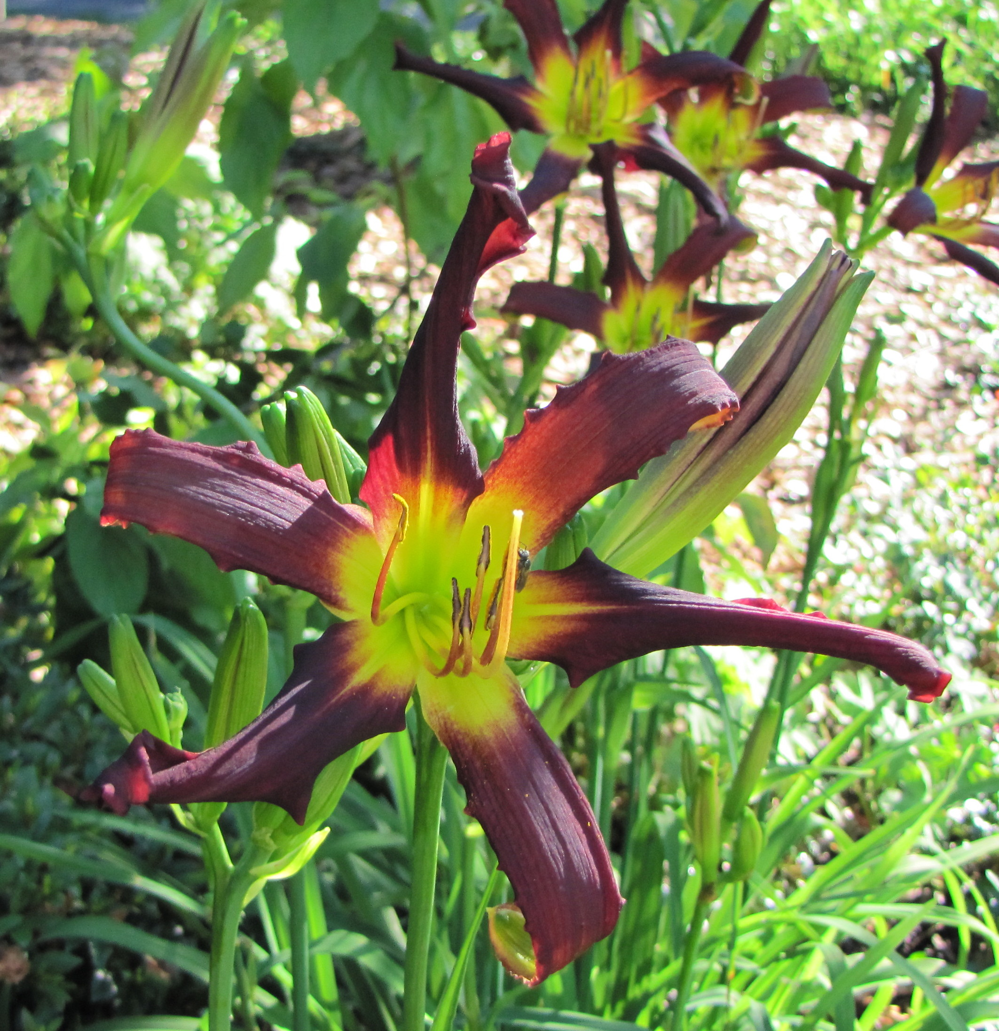
1. Boy From Tupelo

Slide 3
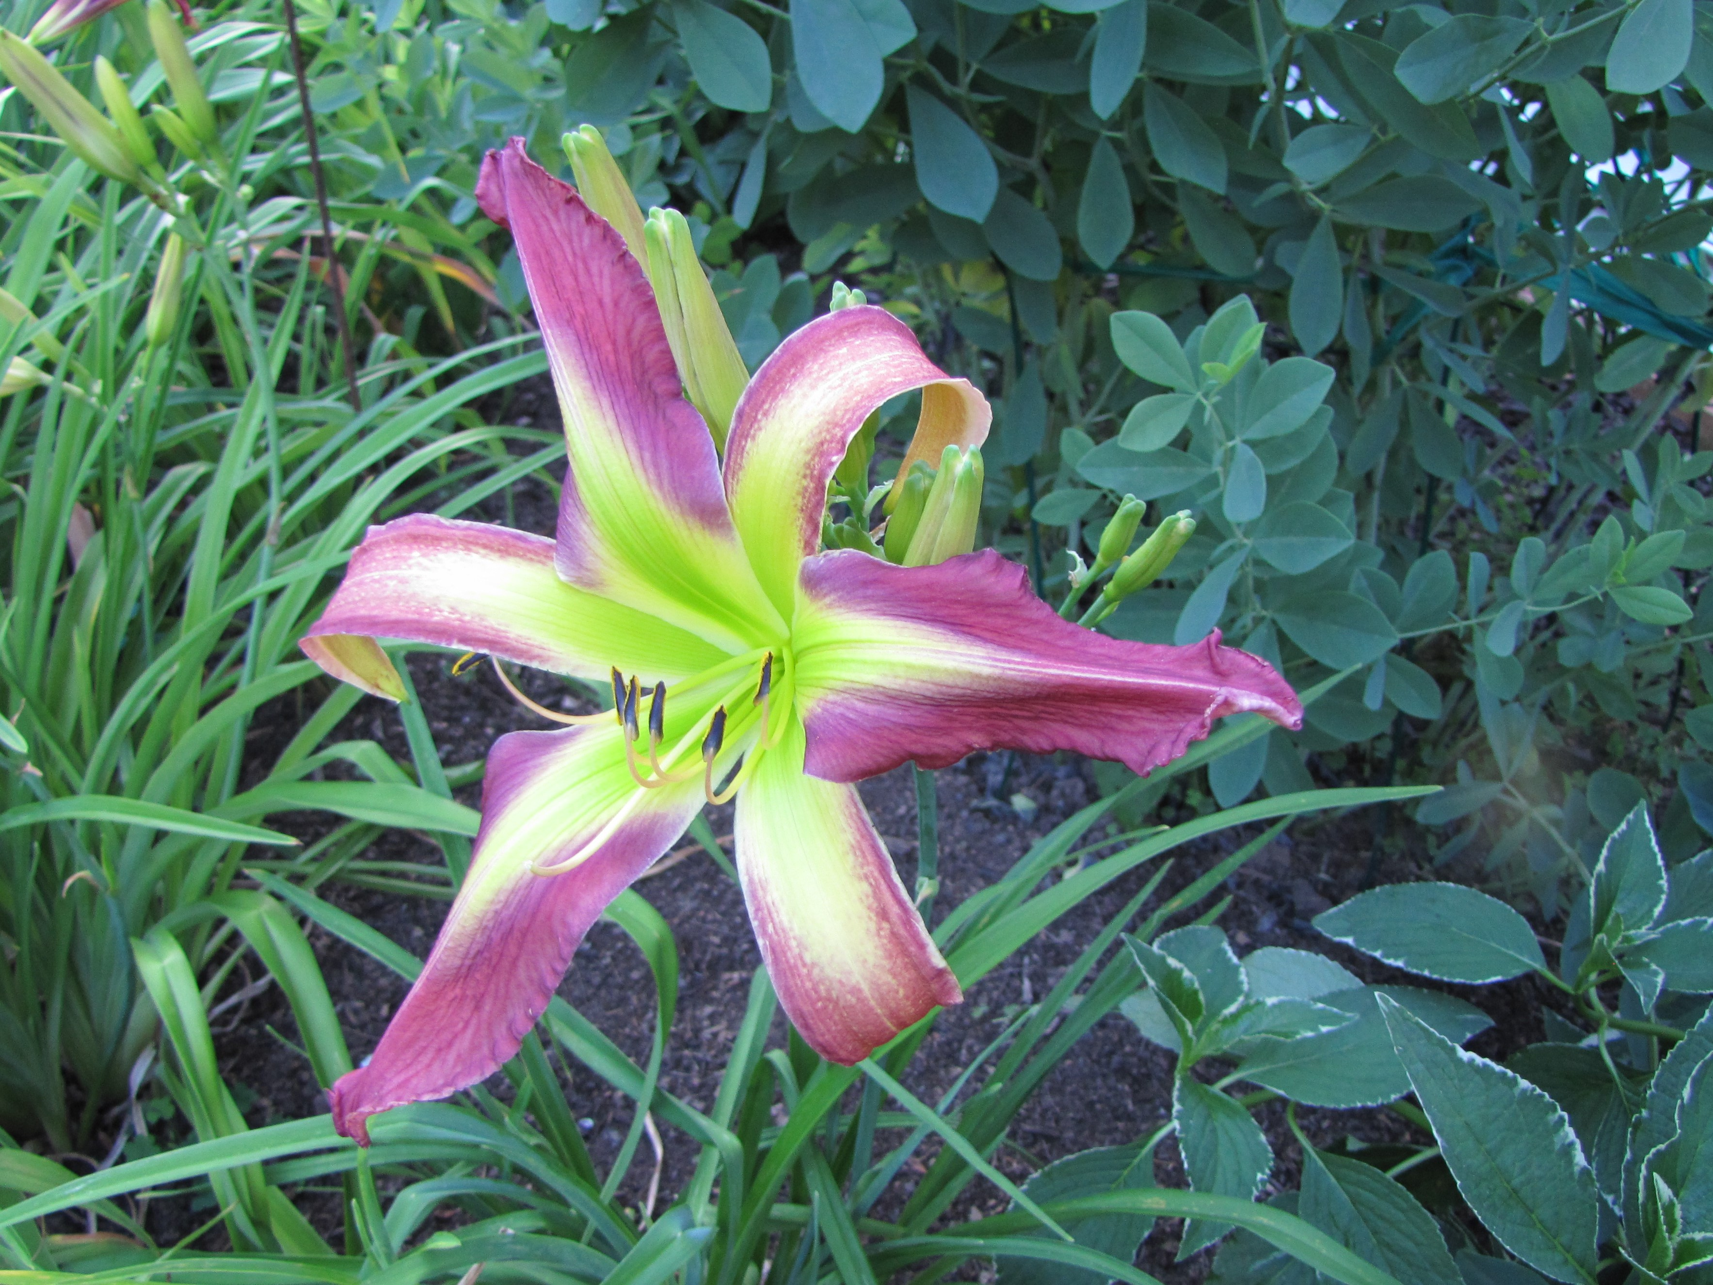
2. Purple Horse Of Oz

Slide 4
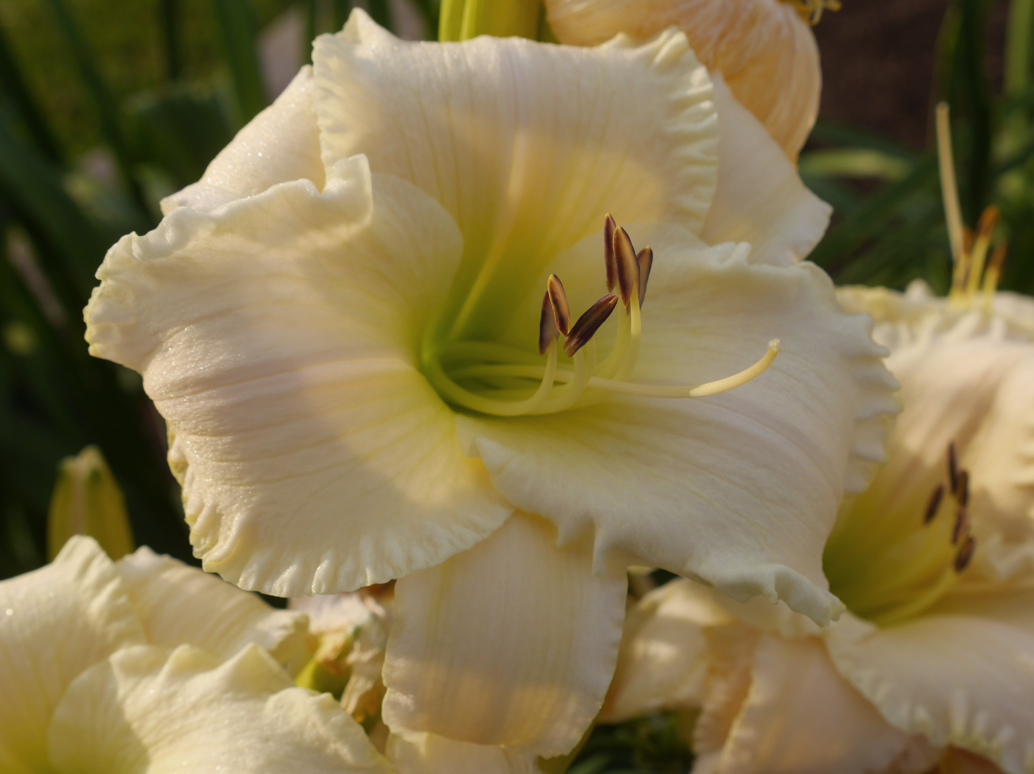
3. The Snow Moon

Slide 5
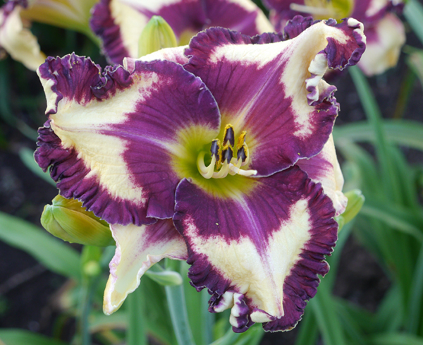
4. Pretty In Purple

Slide 6
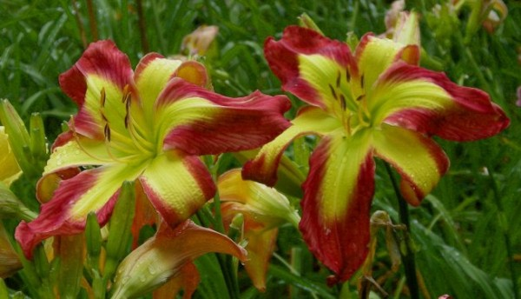
5. Senator Edward M Kennedy

Slide 7
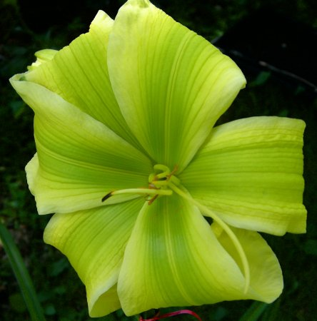
6. Green Icon

Slide 8
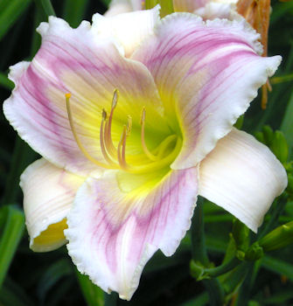
7. Teresa A Mosher

Slide 9
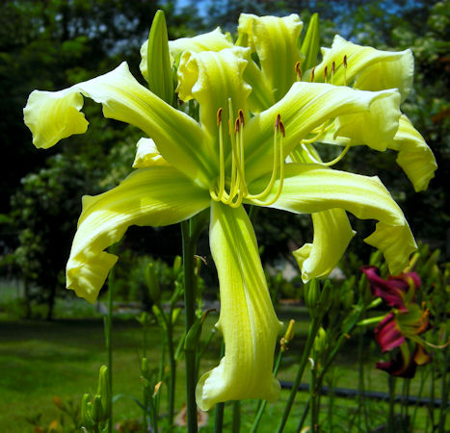
8. Eileen J Trainor

Slide 10
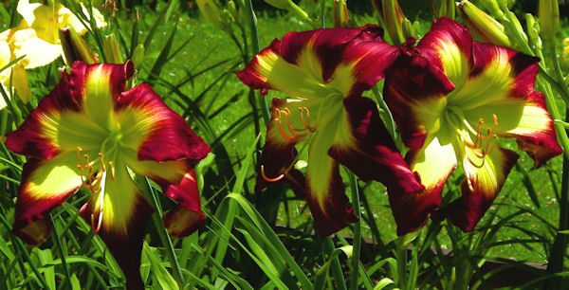
9. Curtis S Noel

Slide 11
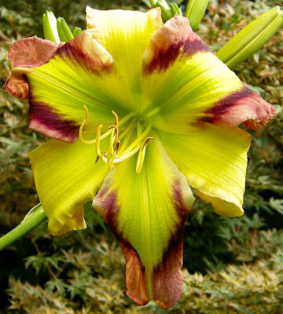
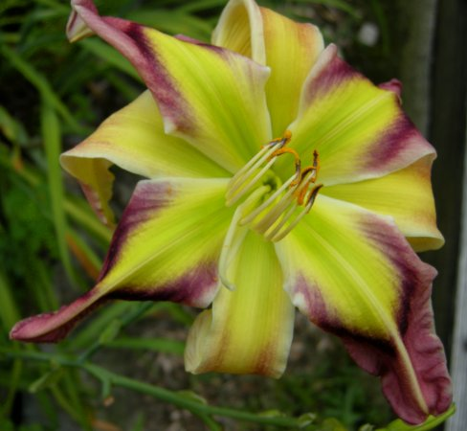
10. Igor F Palacios M.D.

Slide 12
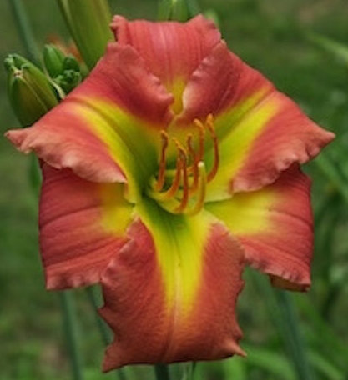
11. Adele Gabriel

Slide 13
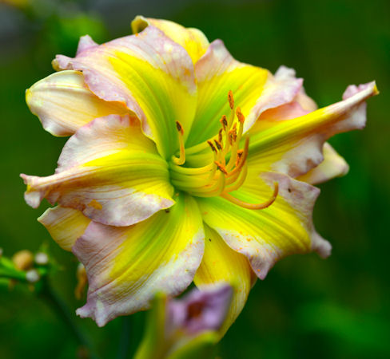
12. Zachary S. Hickey

Slide 14
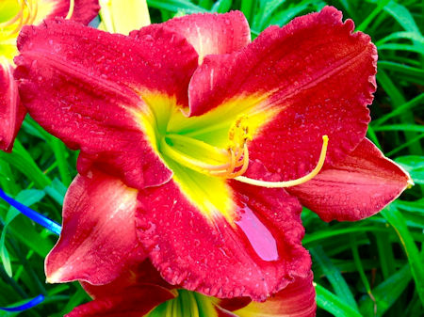
13. Mary L. Lievens

Slide 15
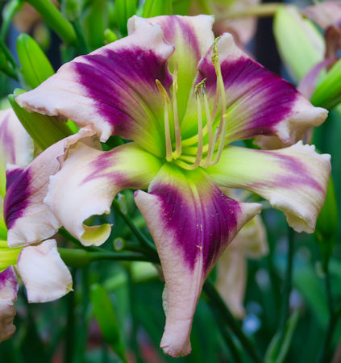
14. Kristen Gunning

Slide 16
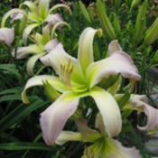
15. Jail Bait

Slide 17
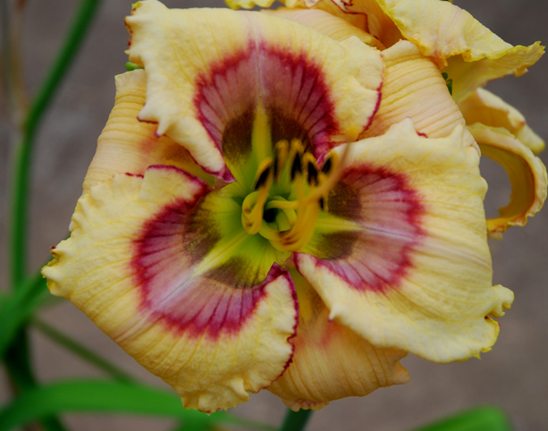
16. Charcoal Eyes

Slide 18
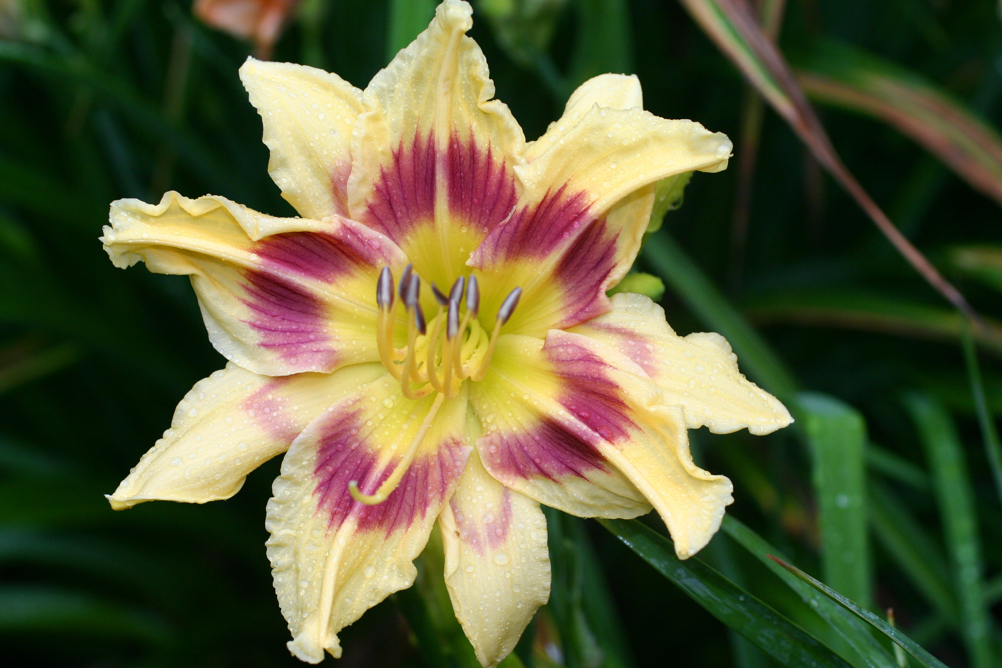
17. Hello Poly

Slide 19
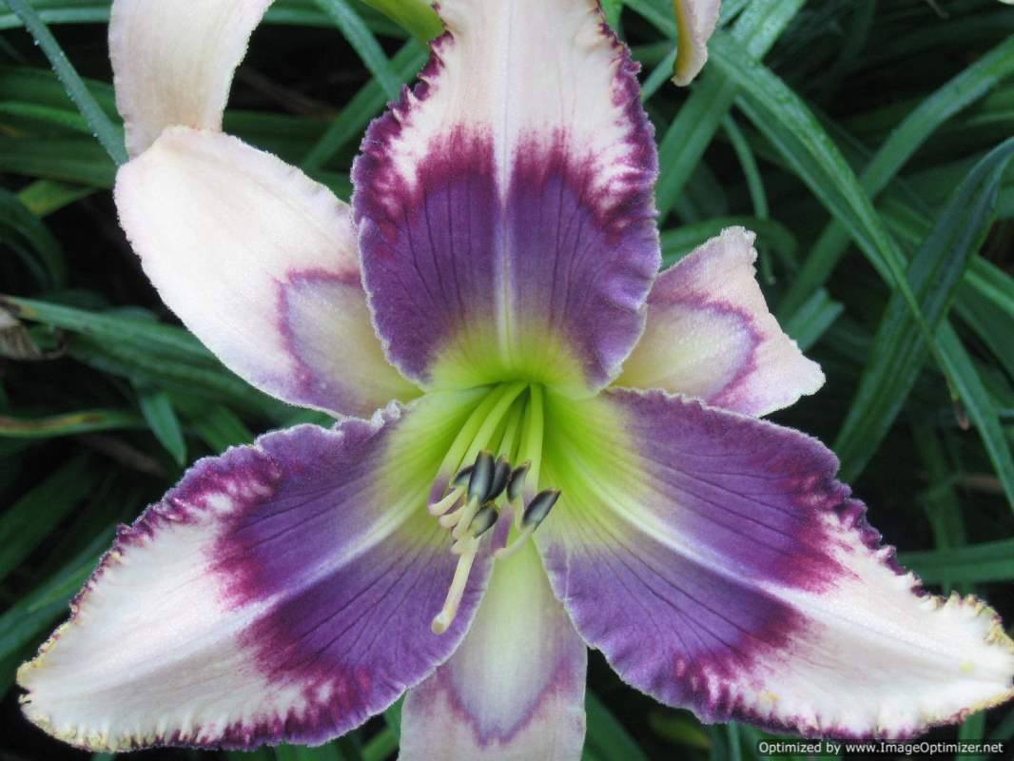
18. Stone Palace Trailblazer

Slide 20
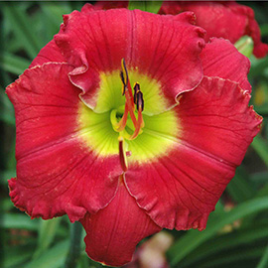
19. Cherryville

Slide 21
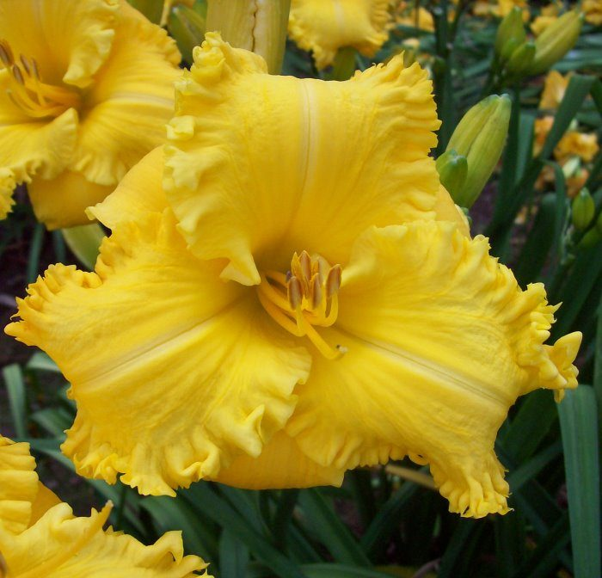
20. Crocodile Tears

Slide 22
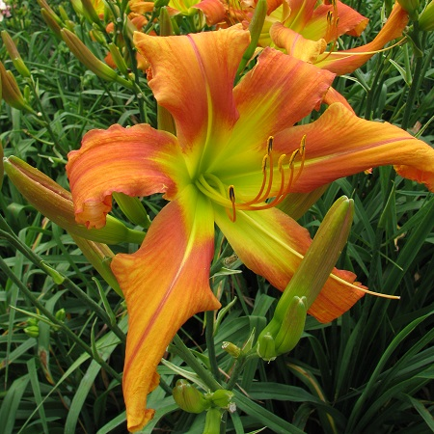
21. Curls Gone Wild

Slide 23
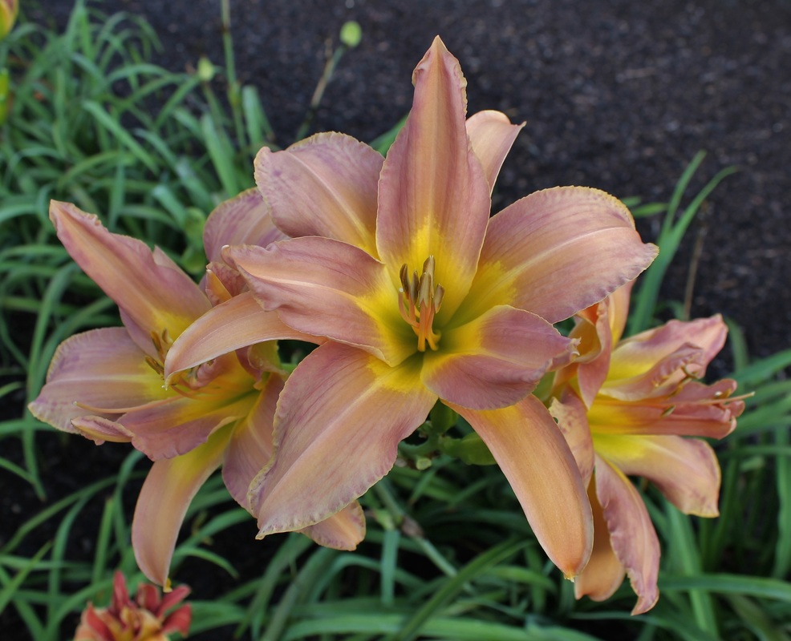
22. All Grown Up

Slide 24
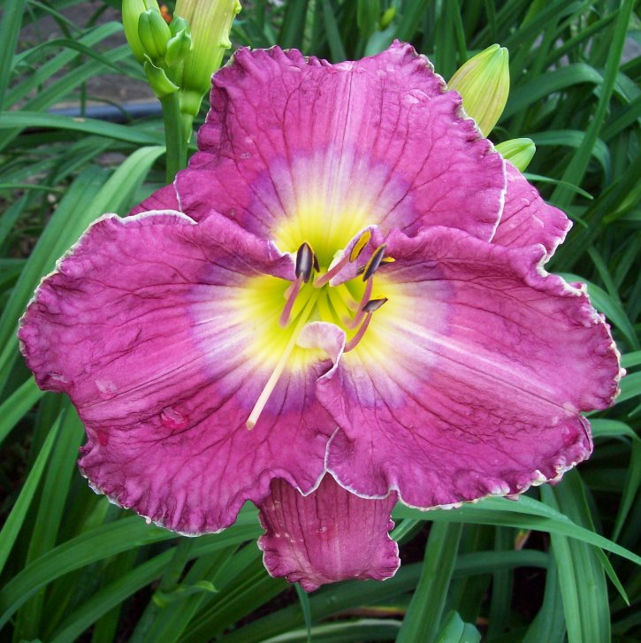
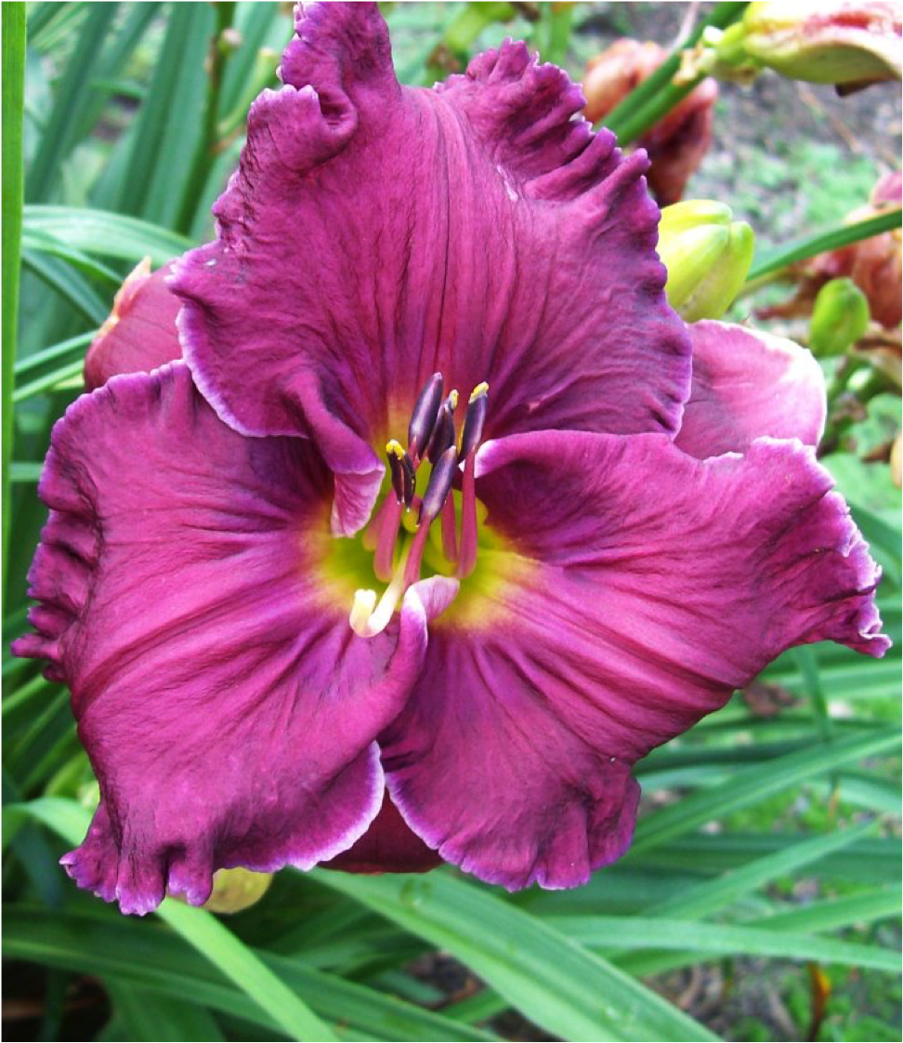
23. Blessing In Disguise
Clouded Judgement

Slide 25
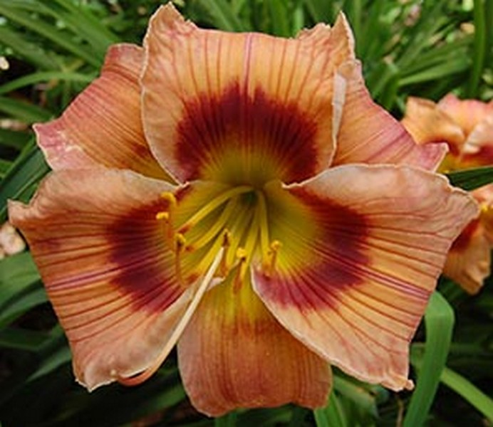
24. Can’t Fault Ya

Slide 26
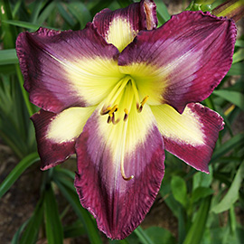
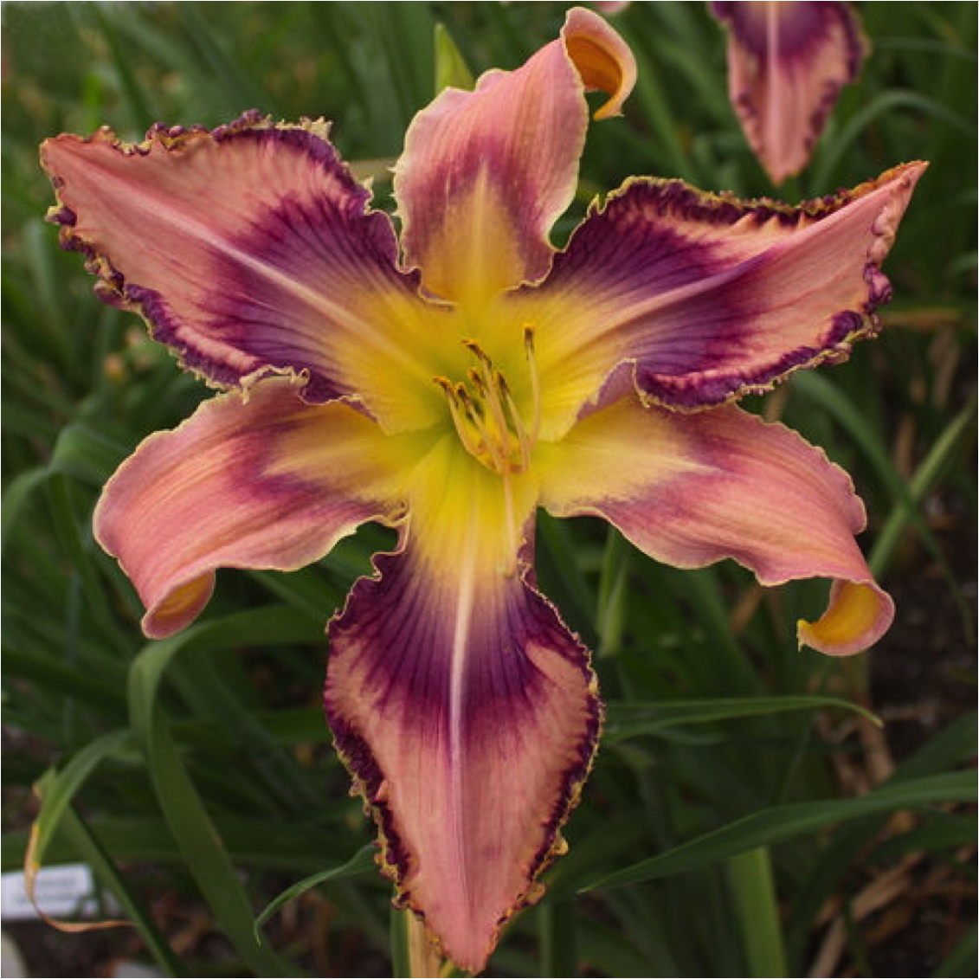
26. Dave
Entwined In The Vine

Slide 27
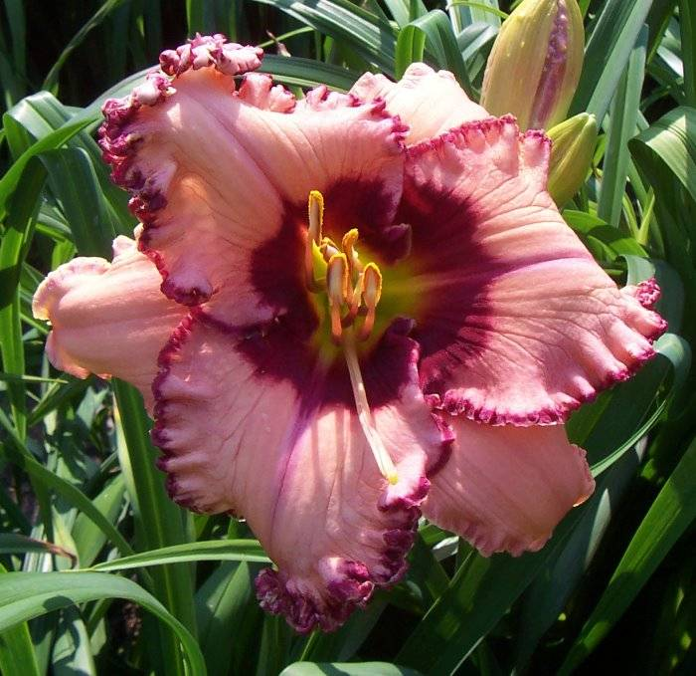
29. Frilled To Death

Slide 28
30. Happy Little Guy

Slide 29
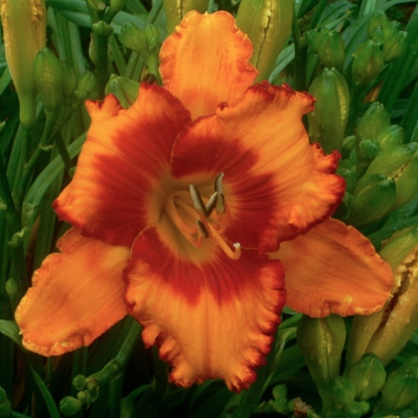
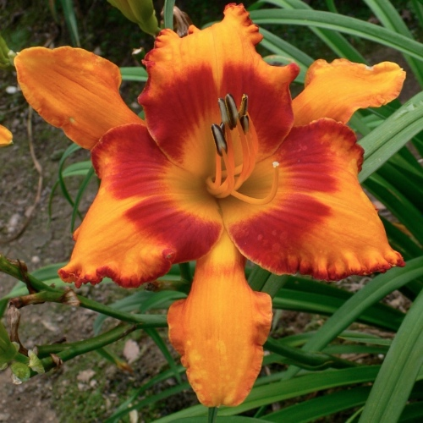
31. James Parker

Slide 30
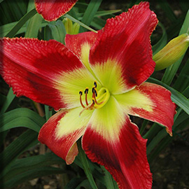
32. Jordan’s Jazz

Slide 31
33. Kimmers

Slide 32
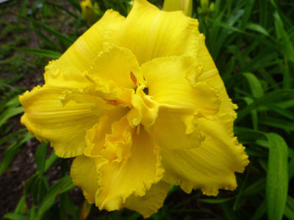
34.Kristi’s Enchantment

Slide 33
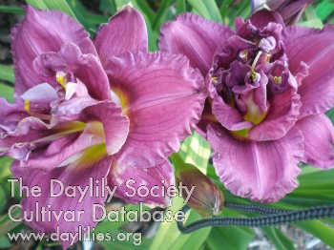
35. Music Of Hope

Slide 34
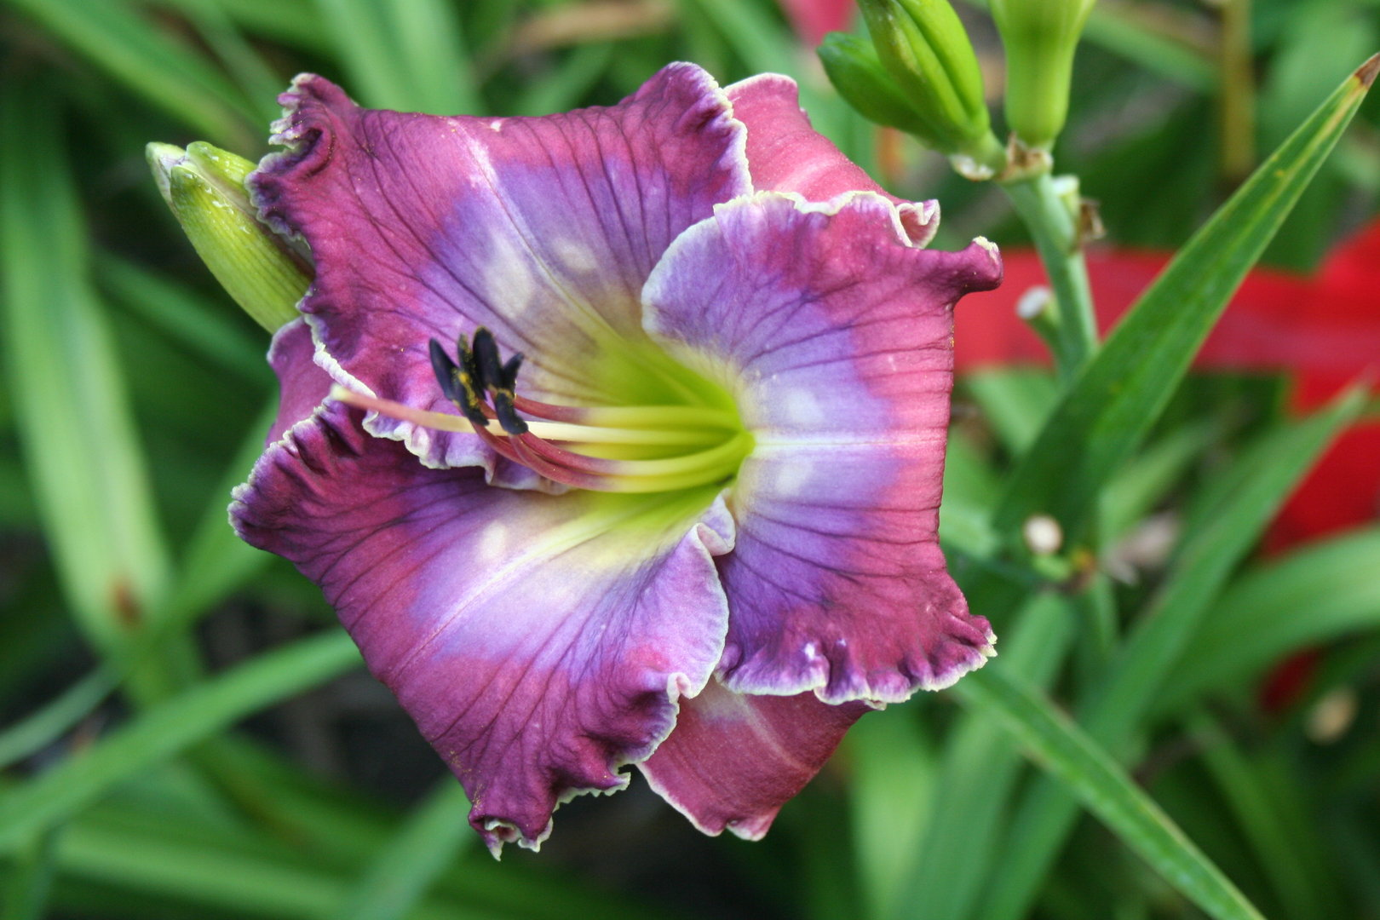
36. Nellie Rarick Memorial

Slide 35
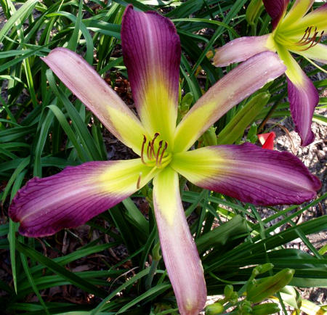
37. Small World Grape Popsickle

Slide 36
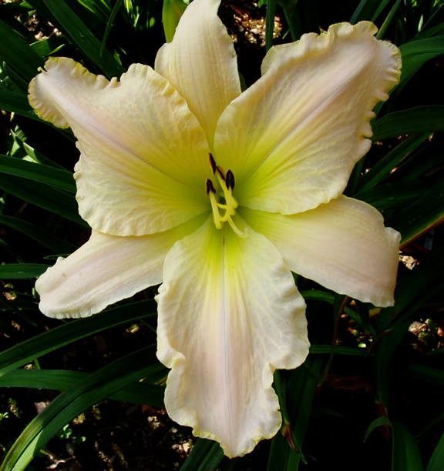
38. Small World Hoot Owl

Slide 37
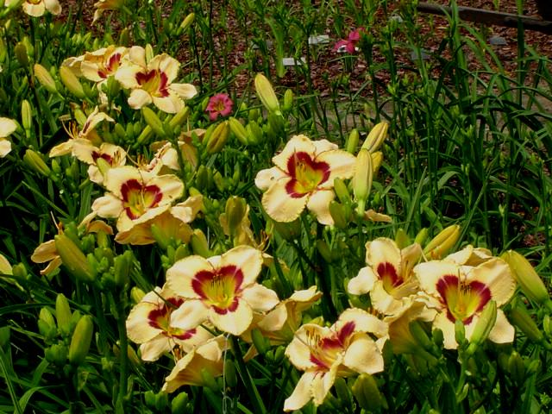
39. Small World Showoff

Slide 38
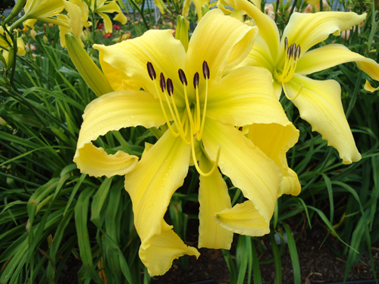
40. Small World Sweet Shining Yellow

Slide 39
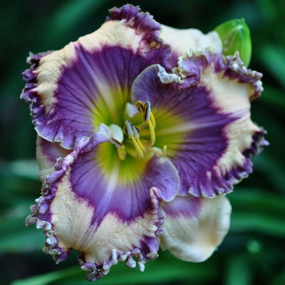
42. Smooth Talker

Slide 40
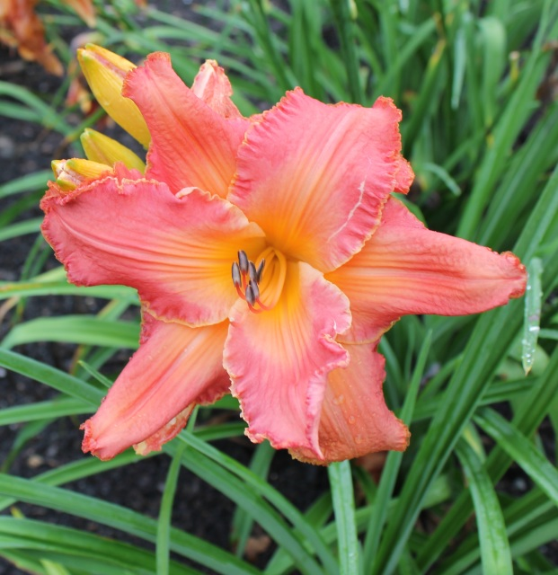
43. Southern Dance

Slide 41
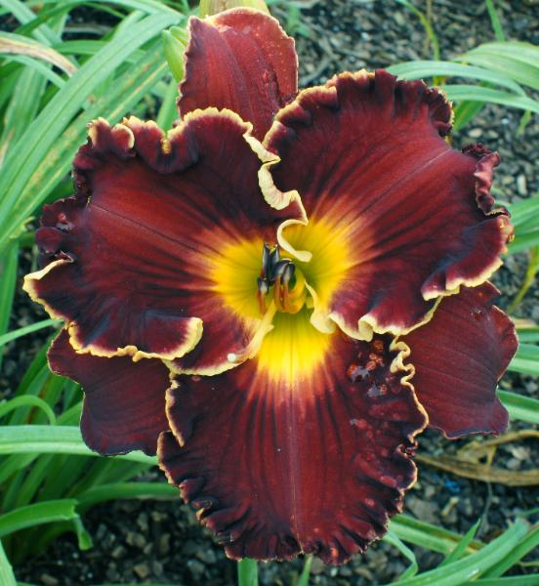
44. Spacecoast Five O’Clock Somewhere

Slide 42
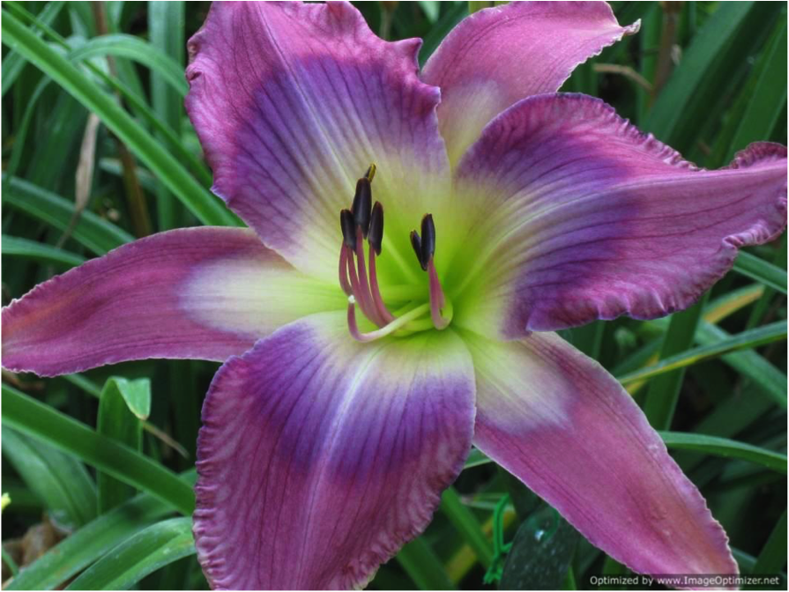
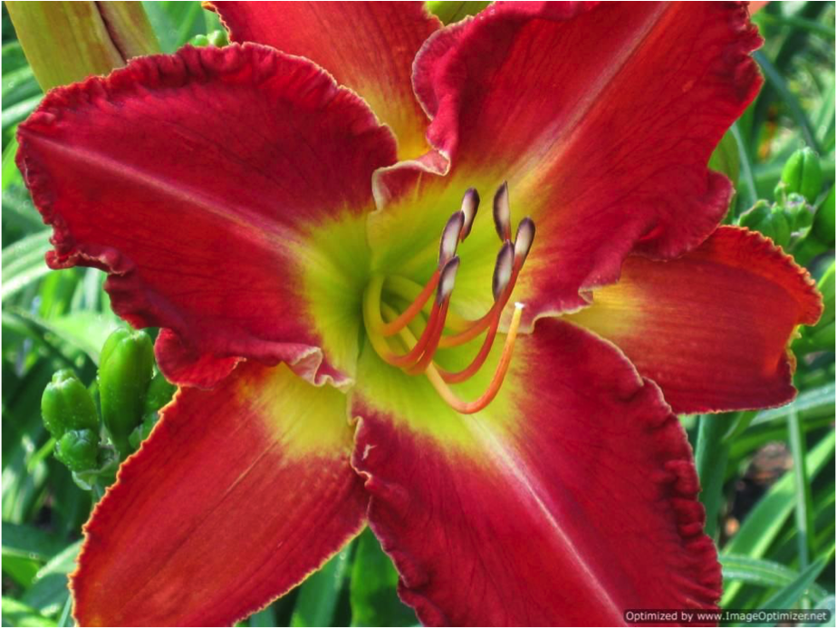
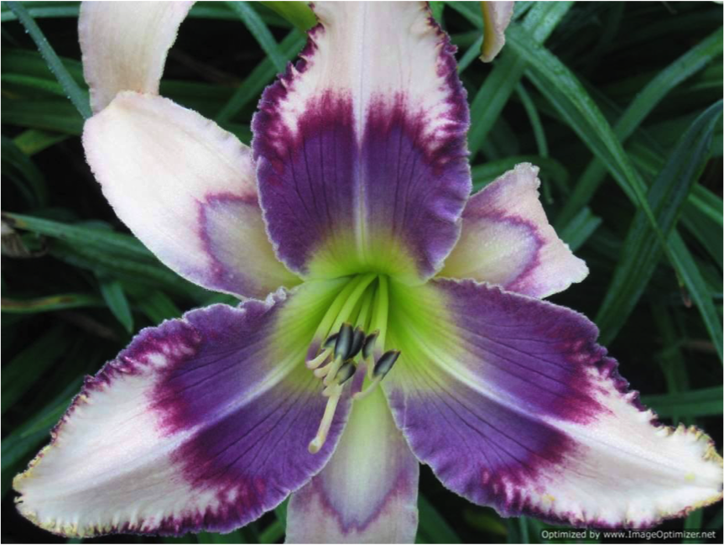
45 Stone Palace Gold Dust Stone Palace Magic Stone Palace Merrymaker Stone Palace Trailblazer

Slide 43
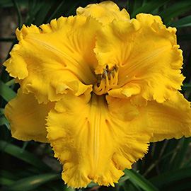
49. Tom Leonard

Slide 44
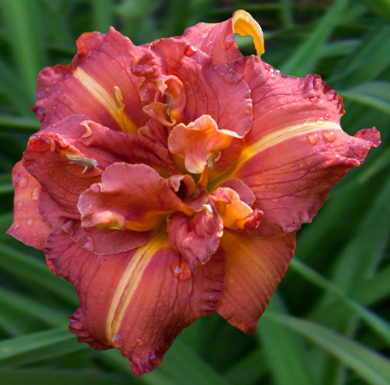
50. Tim Herrington

Slide 45
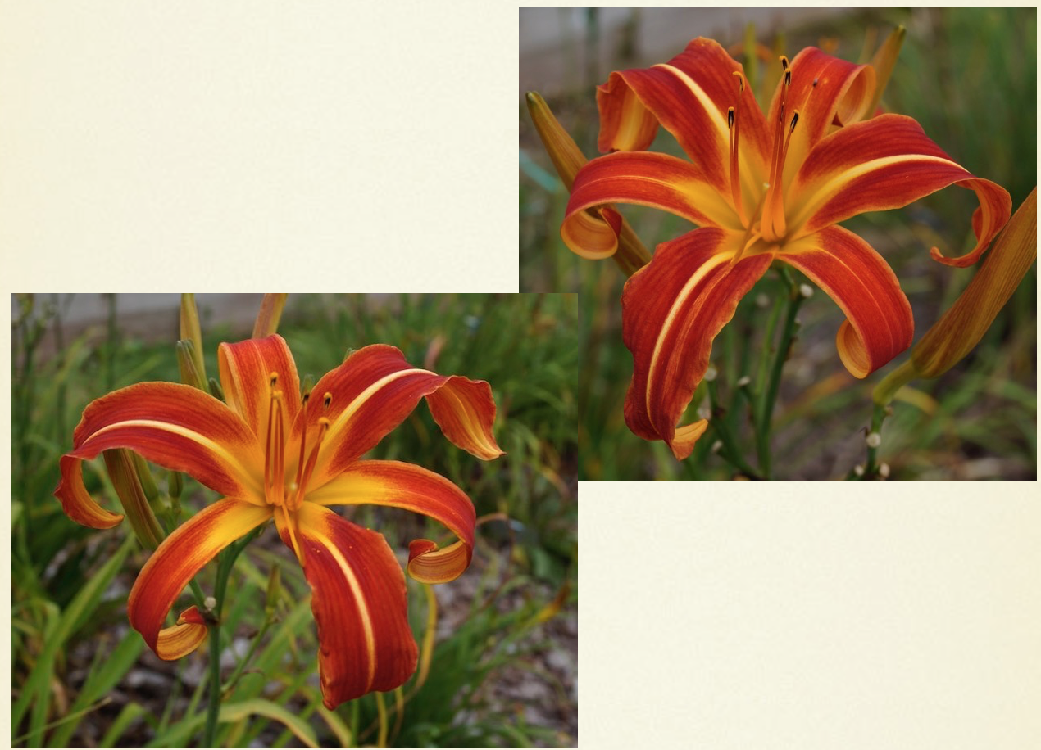
51.Woodlands Scarlet Ibis

Slide 46
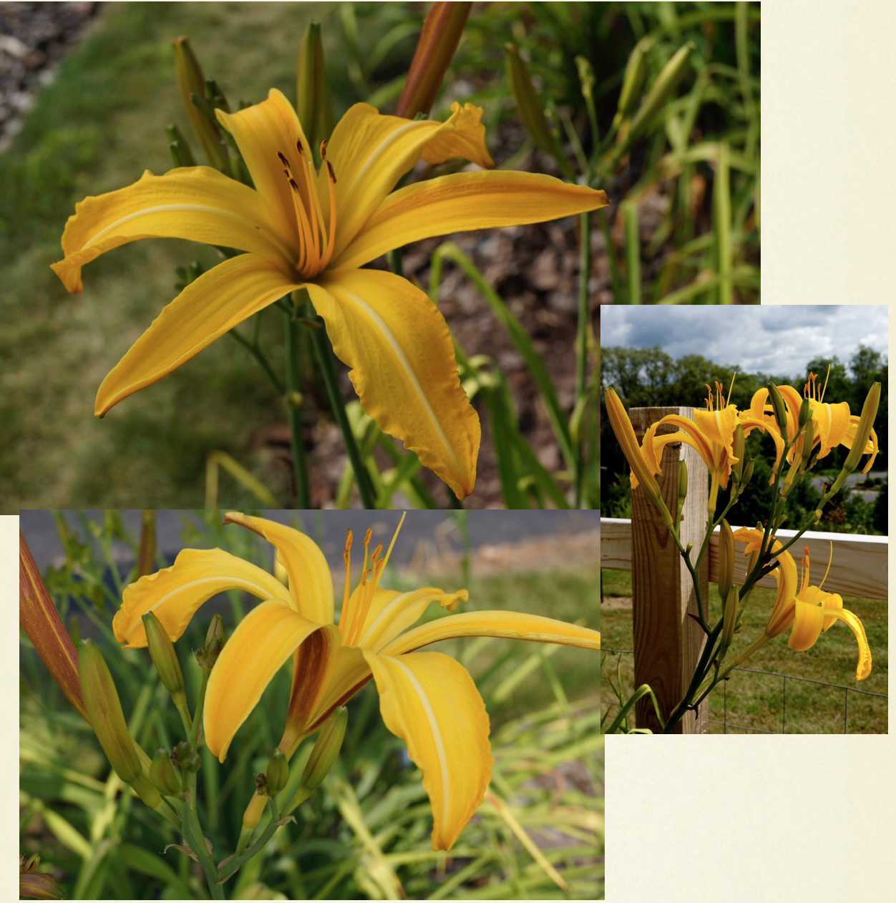
52. Woodland Baltimore Oriole

Slide 47
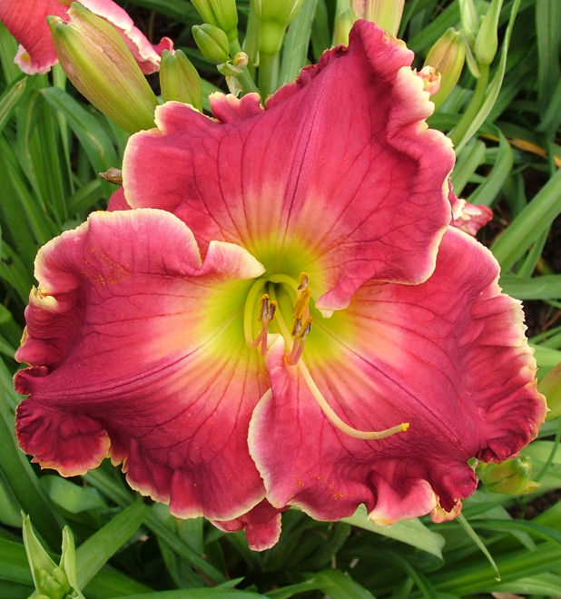
53. Devil Woman

Slide 48
54. Kathy’s Cat Spooky

Slide 49
55. Rascal Fringe

Slide 50
56. Tom Cox

Slide 51
57. Head Of The Class

Slide 52
58. Eileen J Trainer

Slide 53
59. Fan Flare

Slide 54
60. Mo River Heritage

Slide 55
61. Olympic High Divide

Slide 56
63. Rooftop Sunbeam

Slide 57
64.
Olympic Gnome
Olympic Forest Whisper

Slide 58
65. Olympic Forest Whisper

Slide 59
66. Lily Creek Dazzler

Slide 60
67. Pink Lemonade Blush

Slide 61
68. Fuschia Frolic

Slide 62
69. Raspberry Lime Granita

Slide 63
70. Magic In The Air

Slide 64
71. Red Hot Miracle

Slide 65
72. Two Headed Firedragon

Slide 66
73. Ivory Moonbeams

Slide 67
74. Double Magician

Slide 68
75 Fire Scorpion.

Slide 69
76. Catwalker

Slide 70
77. Heavenly Pearl Of Wisdom

Slide 71
78. Well, Hello Beautiful

Slide 72
79. Blackberry Lime Kiss

Slide 73
80. Ultimate Spider-Man

Slide 74
81. Heavenly Dream On

Slide 75
82. Heavenly Mirage

Slide 76
83. Prowler

Slide 77
84. Blushing Dragon

Slide 78
85. Skywarp

Slide 79
86. Lime Blueberry Cream

Slide 80
87. Sensual Sunset

Slide 81
88. Snowflakes and Cashmere

Slide 82
89. Ratchet

Slide 83
90. Master Disaster

Slide 84
91. Spyro The Dragon

Slide 85
92.Cosmic Starburst

Slide 86
93. She Glows

Slide 87
94. Yellow Cupcakes

Slide 88
95. Giant Huntsman

Slide 89
96. Twilight Woods

Slide 90
97. Lemon Pomegranite Cream

Slide 91
98. It’s Miller Time

Slide 92
99. So Delightful

Slide 93
100. Heavenly Dark Knight

Slide 94
101. Small World Big Pink Lollypop

Slide 95
102. Fours Are Wild

Slide 96
103. Porky’s Revenge

Slide 97
104. Highland Park Mark And Mary
Stone Palace Merrymaker

Slide 98
105. Stone Palace Merrymaker

Slide 99
106. Saturday Night Fish Fry

Slide 100
107. Wishful Dreaming

Slide 101
108. Drumline

Slide 102
109. Jewel Of Jupiter

Slide 103
110. Well, Hello Beautiful

Slide 104
111. Crimson Dragon

Slide 105
112. Charlie Harper’s Bizarre

Slide 106
113. Parrots Of The Caribbean

Slide 107
114. Alien DNA

Slide 108
115. Blazing Canons

Slide 109
116. Born In Fire

Slide 110
117. Cherry Cordial Cupcakes

Slide 111
118. Henry Of Hingman

Slide 112
119. Ivory Titan

Slide 113
120. Kissed By Moonlight

Slide 114
121 Papa Goose.

Slide 115
122 Stephen Smith.

Slide 116
123. Sunset Rendezvous

Slide 117
124. Winged Serpent

Slide 118
125. A.W. Shucks

Slide 119
126. Chickens On The Porch

Slide 120
127. Katisue Herrington

Slide 121
128. Pointing Fingers

Slide 122
129. Unbound

Slide 123
130. Carnival King

Slide 124
132. Adventures In Oz

Slide 125
133. Futuristic Fantasy

Slide 126
134. Grape Pearls

Slide 127
135. Judi Romano

Slide 128
136. Perfect Pose

Slide 129
137. Twisted Whiskers

Slide 130
138. Alien Galaxy

Slide 131
139. Barbara Nickle

Slide 132
140. Belle Parisienne

Slide 133
141. Built On The Rock

Slide 134
142. Crocodile Tears

Slide 135
143. Fairy Tale Ending

Slide 136
144. Fuji Screams Forever

Slide 137
145. Nurse’s Stethoscope

Slide 138
146. Prince Farming

Slide 139
147. Santa Croce

Slide 140
148.
Small World Grasshopper
Small World Lighning Bolt
Splendor Of The King

Slide 141
151. Tangerine Machine

Slide 142
152. Tidewater Elf

Slide 143
153. Velvet Hammer

Slide 144
154 Zero To Sixty.

Slide 145
155. Bed Head

Slide 146
156. Space Cowboy.

Slide 147
No photo for Blood Noir
157. Blood Noir Sultan

Slide 148
159. Rooftop Sunbeam Rooftop Sunbeam Beve’s Curls

Slide 149
162. Long Legged Cowboy

Slide 150
163. Marjorie’s Goodness

Slide 151
165. Ravencroft Happy Go Lucky

Slide 152
166. Gryphon Prague Gothic

Slide 153
167. Pink Viper

Slide 154
168. Sunset Ruffles

Slide 155
169. Spiked Buttermilk

Slide 156
170. Dating A Royal

Slide 157
171. Lightsaber Duel

Slide 158
172. Hometown Strong

Slide 159
173. Olympic Gnome

Slide 160
176. Feast Of The Mau Mau

Slide 161
177. Nature’s Smokey Shadows

Slide 162
178. Do Or Do Not There Is No Try

Slide 163
179. Flutterfest Blufftop Puffball Olympic Roaring Surf Olympic High Divide

Slide 164
180. Blufftop Moonlight

Slide 165
184 Tooth Decay.

Slide 166
185. Arm Candy

Slide 167
186. Broken Chains; Citizen Of Heaven; Rainbow In The Clouds

Slide 168
187. Emotion Sensor

Slide 169
188. You Are Mine

Slide 170
189. Badenoch Beauty

Slide 171
190. White Viper

Slide 172
191. Pink Viper

Slide 173
192.
Citron Ribbons Hillside Bright And Early
June Mist

Slide 174
193. Loretta The Stipples Queen

Slide 175
194. Seismic Cool

Slide 176
195. Rosemary Mussar

Slide 177
196. Cherry Stripes

Slide 178
197. Drop Of Golden Sun

Slide 179
198. Joelene Williams

Slide 180
199. Pumplin Spice Truffle

Slide 181
200. Black Sea Devil

Slide 182
201. Crimson Moon

Slide 183
202.

